Slide 1
BioE 131/231 Team 3: Metagenome Analysis
Members: Michael Fernandez, Karinna Vivanco, Debbie Pao, Jinho Ko, Katherine Bigelow
Notes:
We are team 3 and this is our metagenome analysis.
My name is ….

Slide 2
To-Do
Write up sections of paper.

Slide 3
Project Introduction/Background
Study the relationship between diversity and depth of samples.
Diversity: species abundance and genetic variation.
Focus on an abundant phylum: Acidobacteria.
Hypothesis: Higher diversity in the overall number of species in the population will be correlated with higher genetic variation per species of Acidobacteria.
Notes:
KV:
For our analysis, we chose to explore the relationship between diversity and depth of samples.
We also chose to look at two different aspects of diversity: on a species level and on a genetic level.
For simplicity, we chose to focus on genetic variation within species of one phylum: Acidobacteria. Acidobacteria is an abundant phylum in all soil environments but also have preferred environments in which they thrive. So we thought we could get interesting information by choosing this phylum.
Lastly, we speculated that both forms of diversity would have a similar trend across the data sets. Our hypothesis is “Higher diversity in the overall number of species in the population will be correlated with higher genetic variation per species of Acidobacteria.”

Slide 4
Phylum Acidobacteria
One of the most abundant and diverse on earth, but hard to study
Avg 20% of microbial community in all soil environments
“[O]nly eight of a total of 26 subdivisions are known to have representatives in culture”
Role in soil recovery
Beneficial to nutrient cycling and plant growth
Heavy metals
Predominance in low pH conditions
Lower diversity as pH deviates from neutrality
Kielak, Anna M et al. “The Ecology of Acidobacteria: Moving beyond Genes and Genomes” Frontiers in microbiology vol. 7 744. 31 May. 2016, doi:10.3389/fmicb.2016.00744
Notes:
KV:
The phylum we chose to focus on is Acidobacteria.
Acidobacteria is one of the most abundant and diverse phyla of earth, but is difficult to study.
On average, Acidobacteria makes up 20% of microbial communities in soil environments, but can be as high as 52%
Out of the 26 subdivisions of Acidobacteria, only 8 of them are represented in culture. (as in only some of the subdivision have been documented/cultured)
Acidobacteria also has a role in soil recovery. It is beneficial to soil environments by aiding nutrient cycling and promoting plant growth.
It also speculated that Acidobacter has a role in the reduciton of harmful heavy metals in soil.
Additionally, Acidobacteria also have a preference for low pH environments. As soil pH deviates from neutrality, the number of Acidobacteria species present decreases.

Slide 5
MG-RAST Findings
Majority of our sequences (78.26%) features protein
featured protein included: 0.09% rRNA, 40.39% annotated protein, and 59.52% unknown protein.
Subsystems in our sample: carbohydrates (15.35%), clustering-based subsystems (13.44%), amino acids and derivatives (11.36%), and protein metabolism (7.04%).
In Phylum: Proteobacteria (27.41%), Chloroflexi (23.24%), Acidobacteria (18.45%), and Actinobacteria (9.59%).
Notes:
Lots of data returned from mg-rast; the most represented phyla/species were actually found to be ones that are known to have very large genomes, which may mean that they may not be as prevalent as the data suggests. As with most genomes, a large portion of the metagenome is for metabolism.

Slide 6
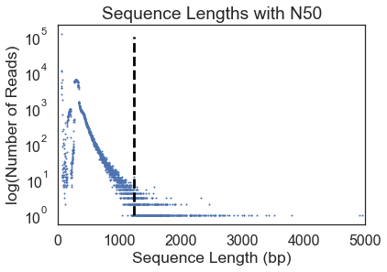
MG-RAST Findings (cont.)
N50 for our layer was 1232 bp
Other groups:
group1 | 2041.0
group2 | 1489.0
group4 | 4631.0
group5 | 4932
group7 | 2863
Notes:
N50: “Half of the genome sequence is in contigs larger than or equal the N50 contig size.”
Not the median
Plotted on a log scale because there were a very large amount of short (~50-100bp) reads
Longer contigs (>1kbp) tended to only have one read at that length
Top len: 4951 bp, average 246.04bp

Slide 7
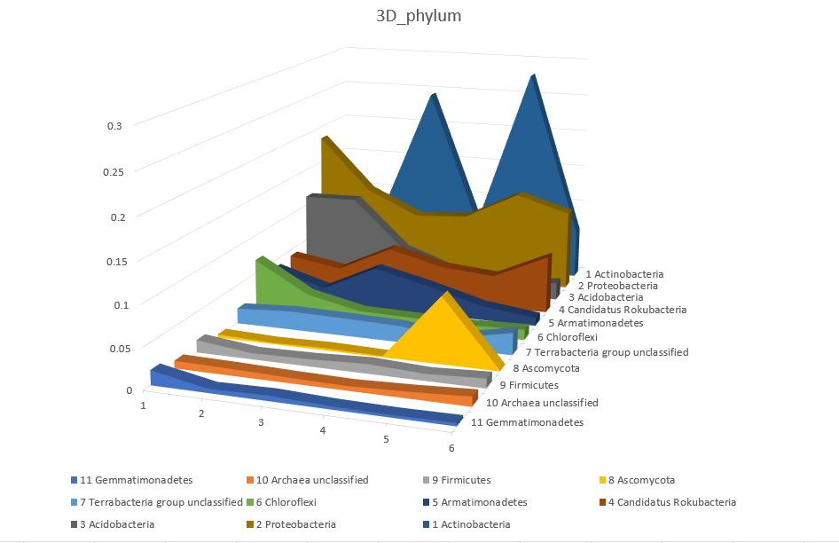
MG-RAST Findings (cont.)
Our group (layer 2)’s most common phyla: Proteobacteria, Chloroflexi , Acidobacteria , Actinobacteria, Firmicutes, Planctomycetes, Cyanobacteria
Notes:
We decided to focus on acidobacteria because:
Focus on one phylum
A very common phylum but not well studied

Slide 8
Metrics Used
Species abundance metric: Alpha & Shannon Diversity
Mean species diversity in a specific area.
Datas from MG-RAST & Calculated using the formation.
Genetic variation metric: Identity score calculations
Identity scores from reads against species reference genome.
Reads annotated via MG-RAST.
Scores obtained via BLAST.
Notes:
In this experiment, we wanted to figure out 2 meterics of diversity, which are species abundance metric and genetic variation metric. We measured each metrics, and finally correlated them in a graph.

Slide 9
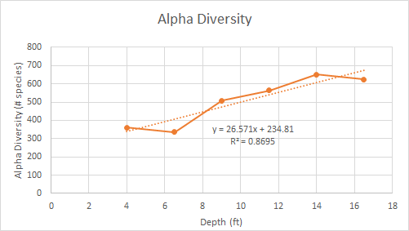
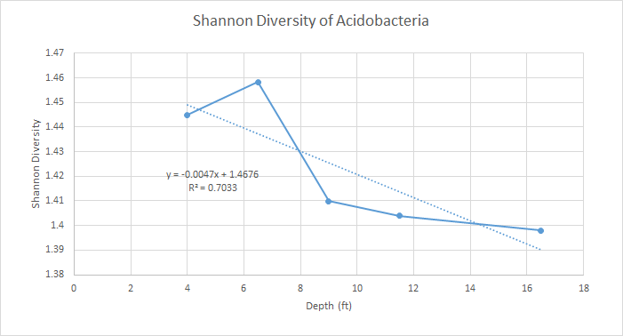

Results: Species Diversity
Shannon diversity
Notes:
Here we have two different diversity metrics: alpha diversity and shannon diversity
In this case alpha diversity, a metric that weighs different specisis per abundance, we used MG-Rast data from 1-6 layers where the sampled population is all specisis. And as you can see this metri increases with depth. Telling us that their is a trend towards increasing diveristy going deeper in the soil
THen we computed shannon diversity for just acidobacteria. Shannon div is first order approximation of alpha diversity, which made the computation much easier for us. The population we are are sampling here is only the acidobacteria found in each layer. Interestingly the diversity of acido bacteria decreased as the depth increased
This points to a trend that acidobacteria is becoming less diverse as the overall diversity increases
This could be because acidobacteria is not as competitive deeper in depth compared to other microbes

Slide 10
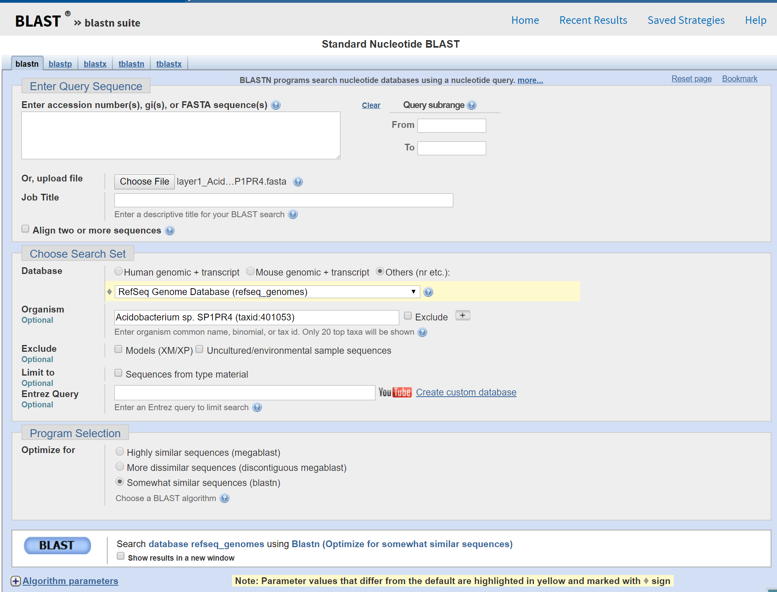
Blast analysis:
Layer and species specific query
Target sequence is the reference genome of that specisis
Top 4 Acidobacteria searched:
Acidobacterium capsulatum ATCC 51196
Acidobacterium sp. MP5ACTX8
Acidobacterium sp. MP5ACTX9
Acidobacterium sp. SP1PR4
Notes:
We then searched per layer 4 different species and how how they matched their reference genome. We first sorted out per acidobacteria species reads per layer. These four acidobacteria are the top 4 species searched from the mg-rast reads. We then ran Blast per each species per each layer, and by setting the target sequence as the reference genome in Blast data. We could get variation numbers, and tried to see standard deviation to find out the genetic variation.

Slide 11
Max score STD relationship to genetic variation
Acidobacterium capsulatum (Depth) | Max score average | Max score STD
Layer 1 (4 ft) | 33.39 | 22.56
Layer 2 (6.5 ft) | 33.89 | 23.533
Layer 3 (9 ft) | 33.39 | 22.56
Layer 4 (11.5 ft) | 39.20 | 37.86
Layer 6 (16.5 ft) | 39.88 | 34.58
Low variation
High variation
Notes:
What we did was gather reads for 1 species of acidobacterium in layer 1 that were all mapped initially to this 1 species
Then we mapped those reads to the actual reference genome for that species
Each read got a score for how well it mapped to that reference genome, and a max score for what the best alignment for that read was
I then took an average of those max reads as well as a standard deviation
The degree to which the max score standard deviation is tell sus how difference the reads were to each other. If they were all every similar in difference to the read then max score std would be low
If the max score std was high then these were reads that varied alot in how well they mapped to the genome → telling us that the reads themselves varied queit alot → therefore the genetic variaton of that species was increasing

Slide 12
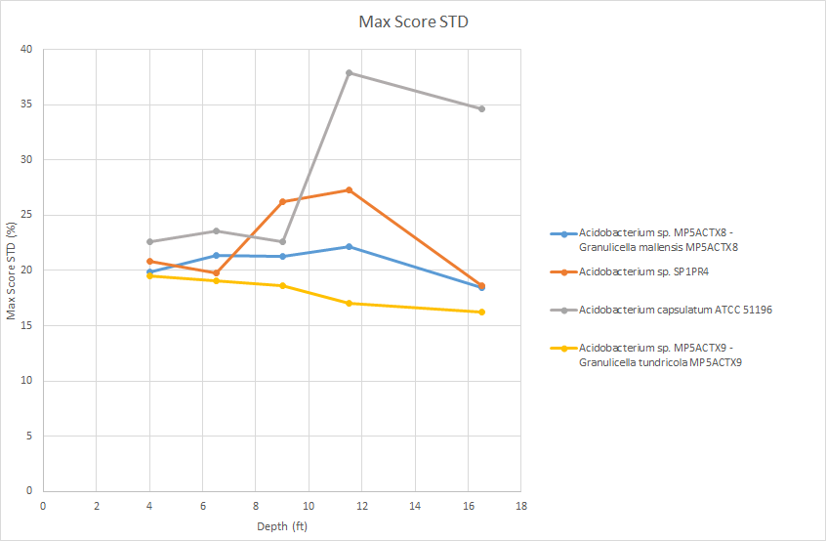
Results: Genetic Variation
Notes:
This graph shows the 4 specisis over all the depths
As you can see the general trend is forthe acidobacterium variation being constant
BUt for acidovacterium capsulatum → the genetic variation increased as we went deeper

Slide 13
Genetic variation increased and remained constant per specisis,
Alpha diversity (whole pop.) increased
Shannon diversity (Acidobacterium) decreased with depth
Notes:
Depending on per specisis the genetic diveristy increased or remain constant per specisis
While alpha diverity increases with depth
And shannon diversity decreased with depth
Acidobacterium capsulatum ATCC 51196 showed this increase with genetic diversity
What is interesting is that this it happens on the junciotn of 3 and 4, from depth 9ft to 11ft. Just 2 feet
Also we can control for the sample, and any errors on part of the sequencing done, as the other specisis in that same dpeth have a much lower value
(can we also make a graph of population of these 4 in relation to each other)
Our hypothesis is that with an increase in diversity of capsulatum → 1 specisis may be better suited and and free reign while the others slowing remain constant or decrease
This would be a further area of study to see difference in reads between acidobacterium capsulatum and the other acidobacterium

Slide 14
Issues
Memory constraints during SPAdes assembly.
Using MG-RAST to find alpha diversity for Acidobacteria.
Using MUSCLE to output an SP score → for alignment of species specific reads
Working with large sample files --running out of memory, etc.

Slide 15
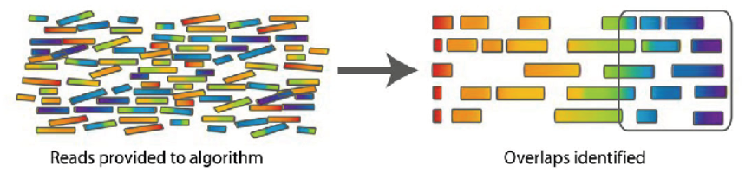
Future Directions
Identify reads on mapped to per species
Map the reads to each other and reconstruct a genome.
Compare that assembled genome to the reference genome and see percent difference
Examine relationship between our diversity metrics and pH for acidobacteria
Notes:
Species reads/make a genome from those
Compare the whole genome
More diversity metrics/can go more into math/look at different metrics from our blast alignments
More literature search on sediment

Slide 16
Q&A

